Slide 1

Speech Enhancement for Signals with Additive White Noise
Gregory Hessler
Kshama Kodthalu Shivashankara
Yue Teng
April 25th 2022

Slide 2

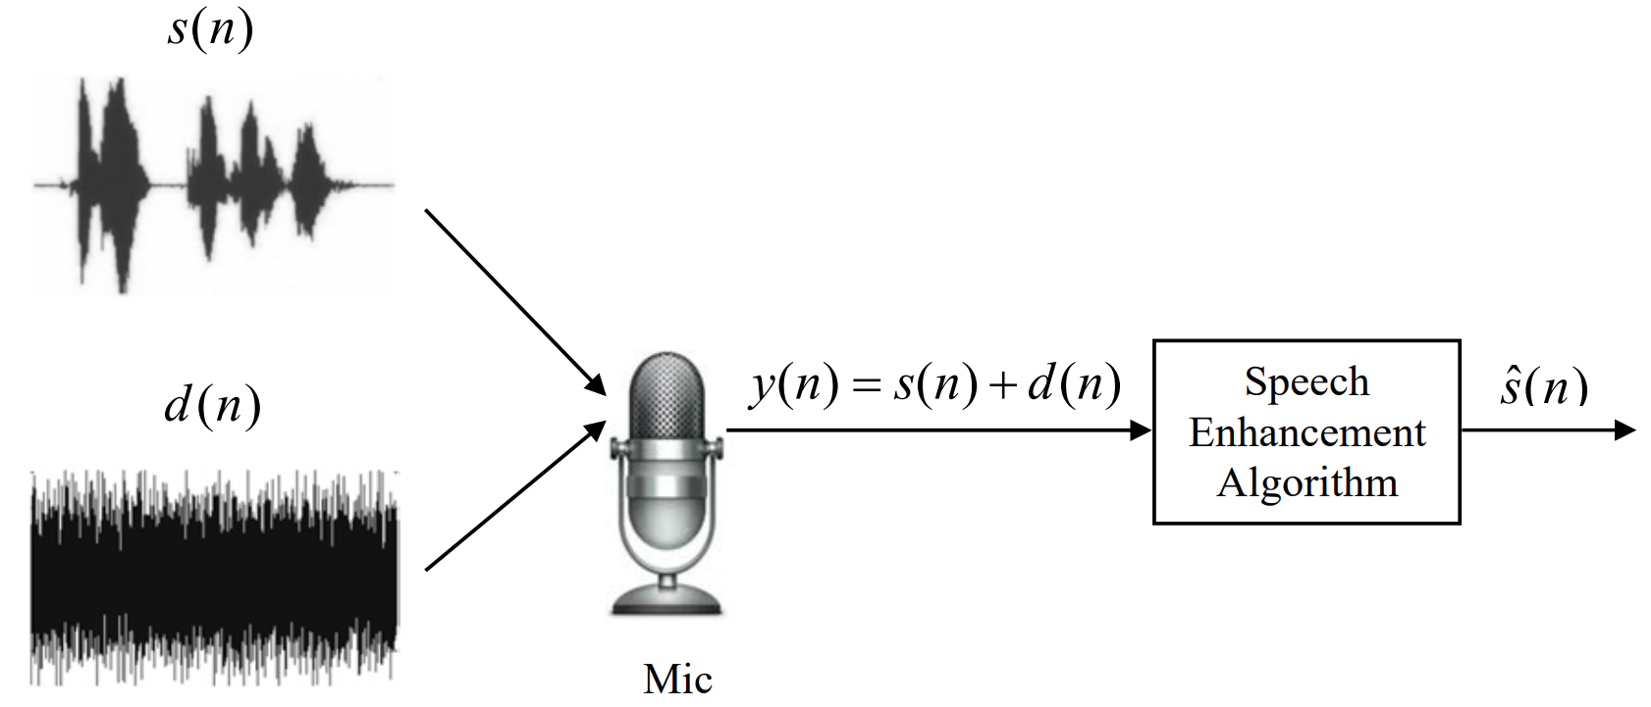
Introduction:
Goal: to remove additive white noise from speech signals
Diagram citation: [1]

Slide 3


Problem Formulation
We segment the noisy speech signal into frames indexed by k and compute the STFT for each segment:
Uncorrelated background noise results in power spectra with no cross terms:
Need to estimate power spectrum of speech signal:

Slide 4
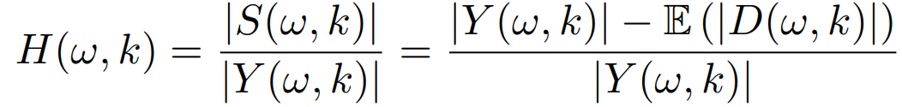


Approach 1: Wiener Filter
We consider a Wiener filter which has the form
Assume the expected power of the noise
is equal to the power in the unvoiced regions.
Hence we have the spectrum of the speech signal

Slide 5
Approach 2: Spectral Subtraction
We can estimate the spectrum of the speech signal as
The spectral subtraction technique introduces an over-subtraction factor, α, which depends on segmental SNR

Slide 6
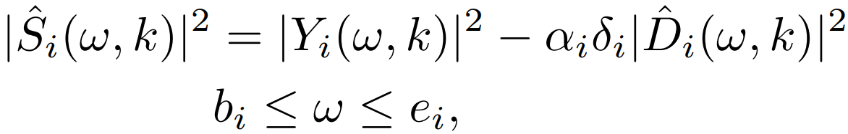
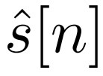
Approach 2: Spectral Subtraction
A more robust multi-band approach
where we compute power spectra in each frequency band.
Note we again have an over-subtraction factor, α, as well as an additional parameter δ to adjust noise removal.
Ultimately apply ISTFT and overlap-add to find enhance speech signal .

Slide 7
Dataset
TIMIT Dataset
5 female utterances and 5 male utterances
Additive White Noise
5 dB, 10 dB, and 15 dB

Slide 8
Evaluation Criteria
SNR
PSEQ
Objective metric to model the subjective human perception of voice quality
Visual assessment of spectrogram
Perceptual auditory assessment of enhanced signal

Slide 9
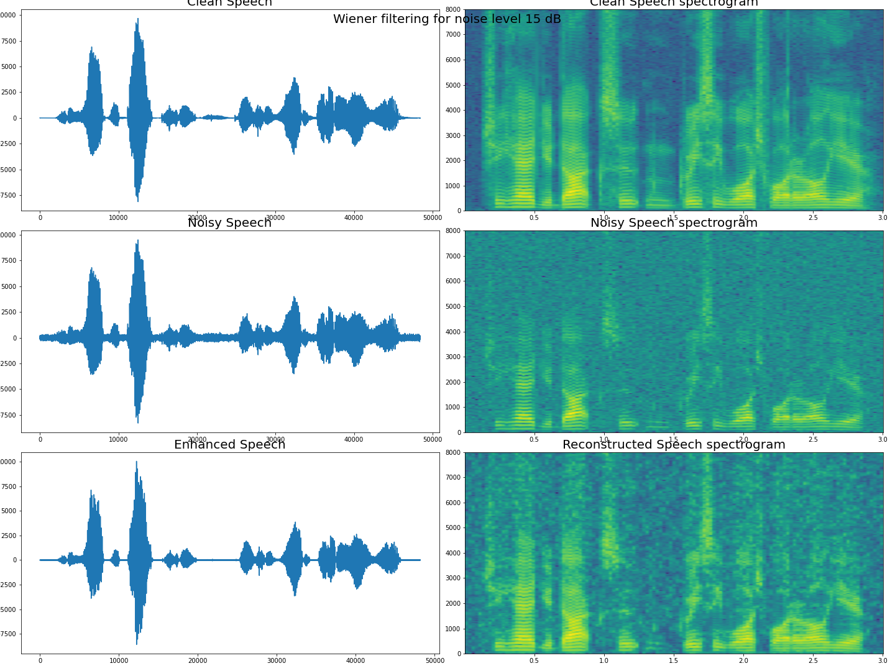
Wiener Filter Performance: Spectrogram
Original:
Noisy:
Enhanced:
Example of 15 dB noise

Slide 10
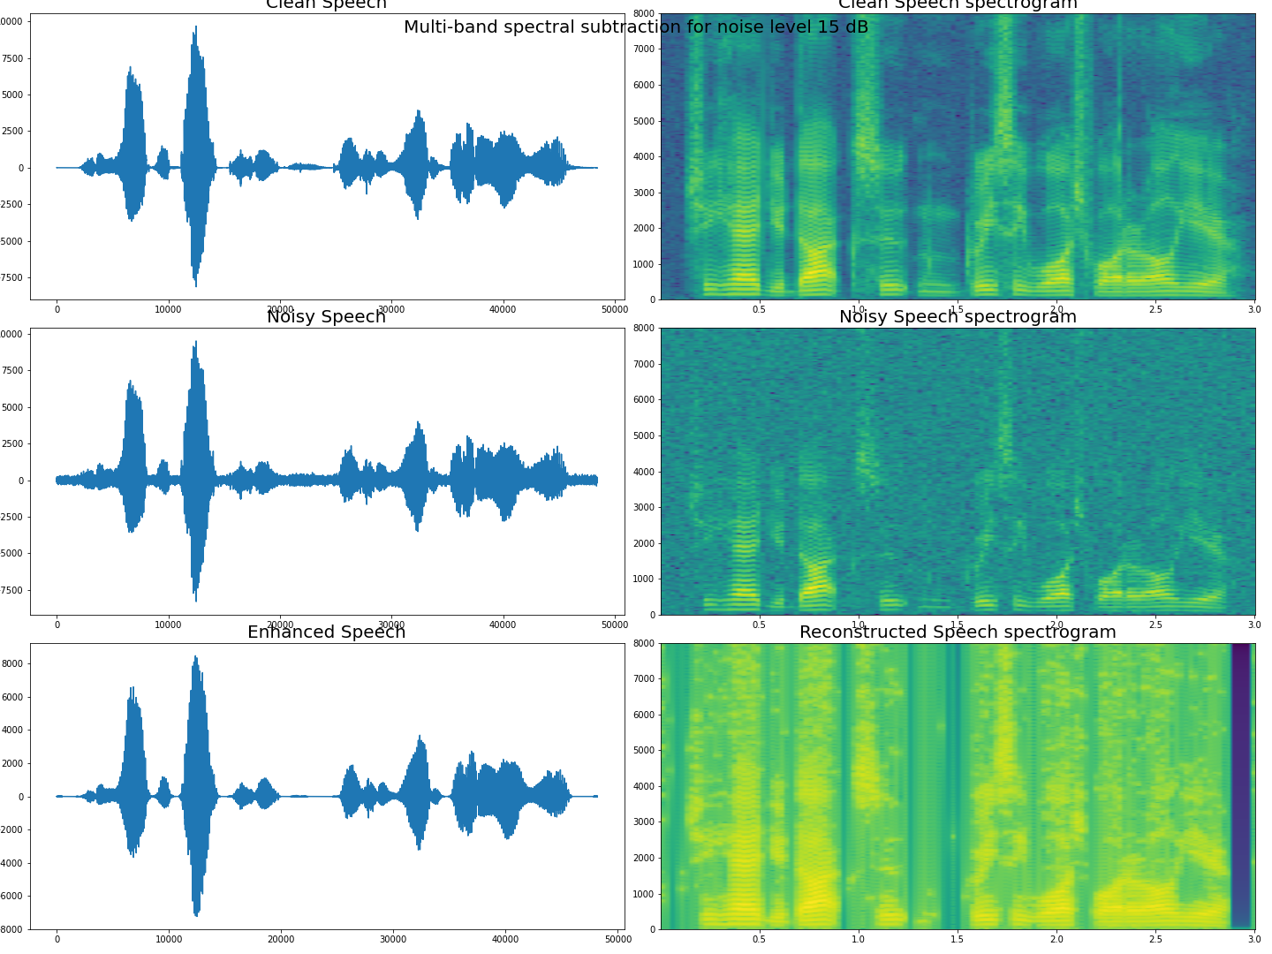
Spectral Subtraction Performance: Spectrogram
Original:
Noisy:
Enhanced:
Example of 15 dB noise

Slide 11
PESQ Comparison
Noise Level | Average Noisy PSEQ | Wiener Filter |  | Spectral Subtraction
 |  | Average PSEQ (Reconstructed) | Average PSEQ Improvement | Average PSEQ (Reconstructed) | Average PSEQ Improvement
5 dB | 1.43 | 1.97 | 0.54 | 1.44 | 0.01
10 dB | 1.71 | 2.50 | 0.79 | 2.02 | 0.31
15 dB | 2.12 | 2.95 | 0.83 | 2.47 | 0.35

Slide 12

Enhanced Speech Signals
Clean signal:
Noisy signal (5 dB SNR):
Enhanced signal (Wiener filtering):
Enhanced signal (spectral subtraction):

Slide 13
Conclusions
For higher noise levels, we see a drop in performance, as it becomes more difficult to distinguish between silent and voiced frames.
Wiener filtering performs better than Spectral subtraction for all noise levels.
Spectral subtraction is not efficient for speech corrupted with non-stationary noise such as car noise, babble noise, helicopter noise.
Spectral subtraction is also not efficient for higher SNRs as it degrades the actual signal too.

Slide 14
References
Navneet Upadhyay, Rahul Kumar Jaiswal, “Single Channel Speech Enhancement: Using Wiener Filtering with Recursive Noise Estimation,” Procedia Computer Science,Volume 84, 2016, Pages 22-30.
A. Rix, J. Beerends, M. Hollier, and A. Hekstra, “Perceptual evaluation of speech quality (pesq)-a new method for speech quality assessment of telephone networks and codecs,” in 2001 IEEE International Conference on Acoustics, Speech, and Signal Processing. Proceedings (Cat. No.01CH37221), vol. 2, pp. 749–752 vol.2, 2001.
M. Berouti, R. Schwartz, and J. Makhoul, “Enhancement of speech corrupted by acoustic noise,” in ICASSP ’79. IEEE International Conference on Acoustics, Speech, and Signal Processing, vol. 4, pp. 208–211, 1979.
S. Kamath and P. Loizou, “A multi-band spectral subtraction method for enhancing speech corrupted by colored noise,” Acoustics, Speech, and Signal Processing, 1988. ICASSP-88., 1988 International Conference on, vol. 4, 05 2002.
N. Upadhyay and A. Karmakar, “An improved multi-band spectral subtraction algorithm for enhancing speech in various noise environments,” Procedia Engineering, vol. 64, pp. 312–321, 2013. International Conference on Design and Manufacturing (IConDM2013).

